Slide 1
Chapter 11 Inventing the Internet

Slide 2
3 Big Ideas of Internet
Packet switching
Distributed hierarchy
Modularization: dividing functions into layers

Slide 3
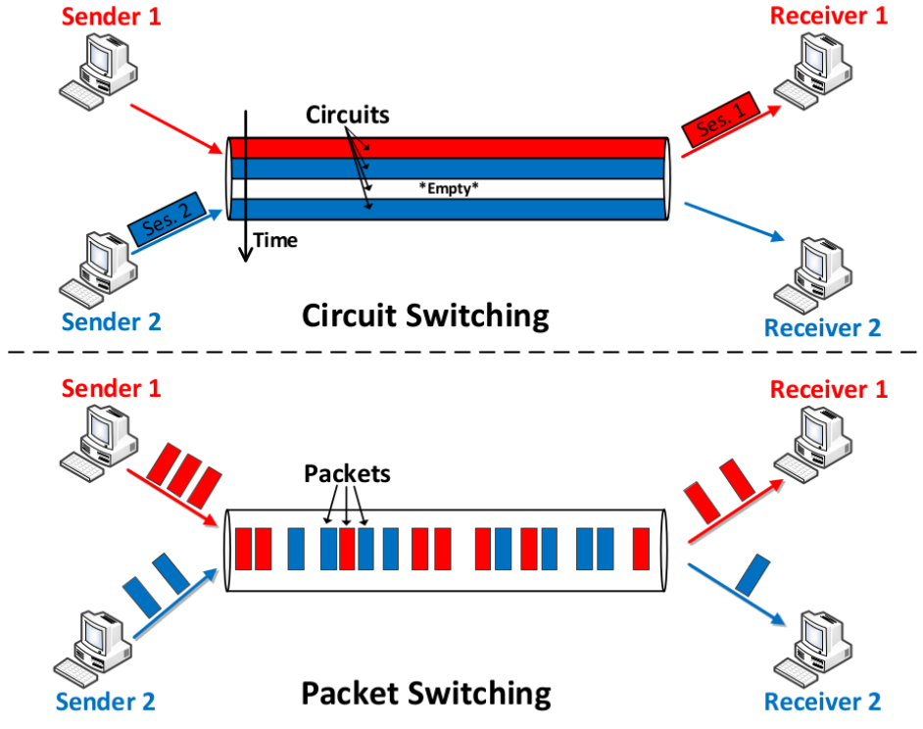
Packet Switching
Circuit-switching
dedicated network resources
FDMA, TDMA, CDMA
not all resources used constantly!
Packet-switching:
sharing network resources
bursty nature of data application

Slide 4
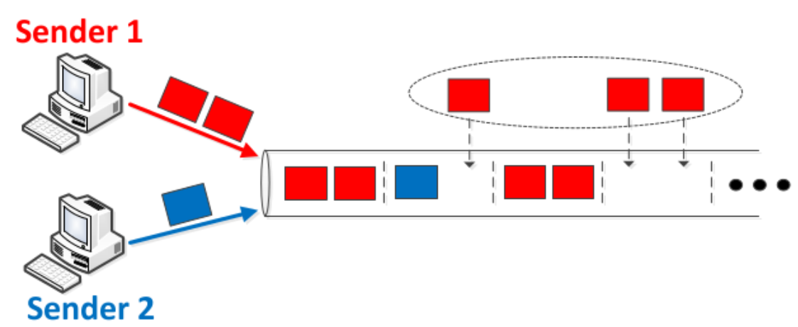
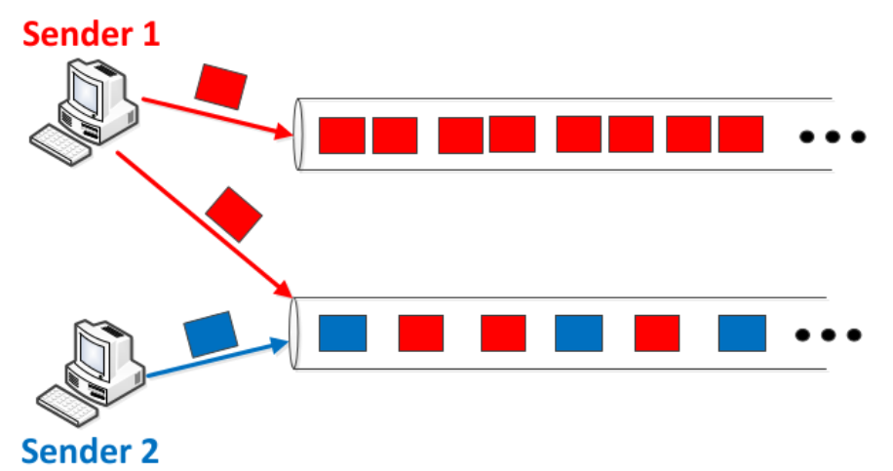
Advantages of Packet Switching
“Statistical” multiplexing
no dedicated resources
multiple sessions can share one path
available supply is used as long as there is unserved demand
not wasting anything when idle
Resource pooling
one session can use multiple paths
Owning a car: dedicated resource
vs. …....

Slide 5
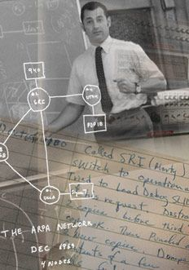
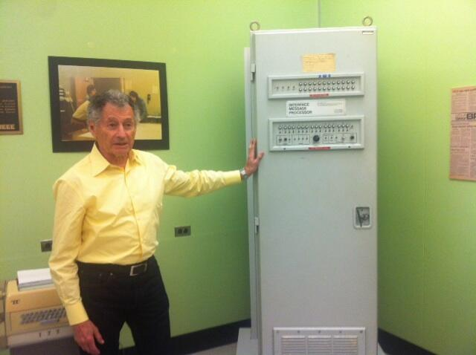
Kleinrock and 1st Router
IMP: Interface Message processor

Slide 6
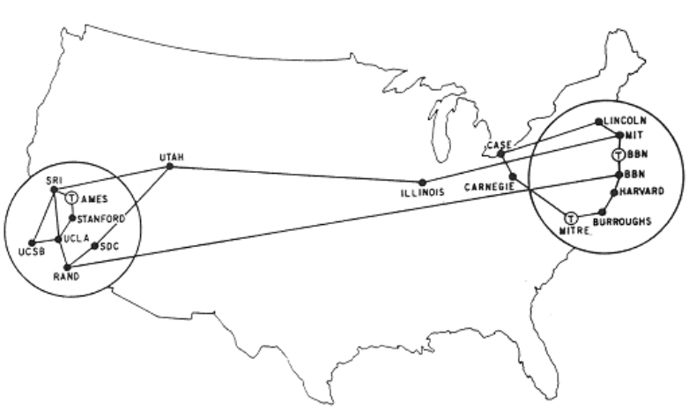
ARPANET
1968: ARPA
Created plan for large packet-switched computer network
1969: BBN Technologies
Received contract to build first computers for network
Growth (ARPANET)
UCLA, Stanford, UCSB, University of Utah
1970 – 9 institutions by June, 13 by Dec, 18 by next September

Slide 7
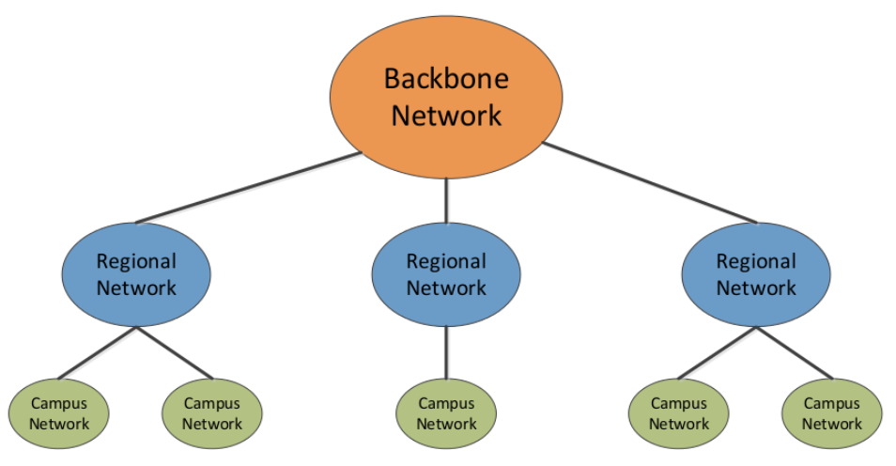
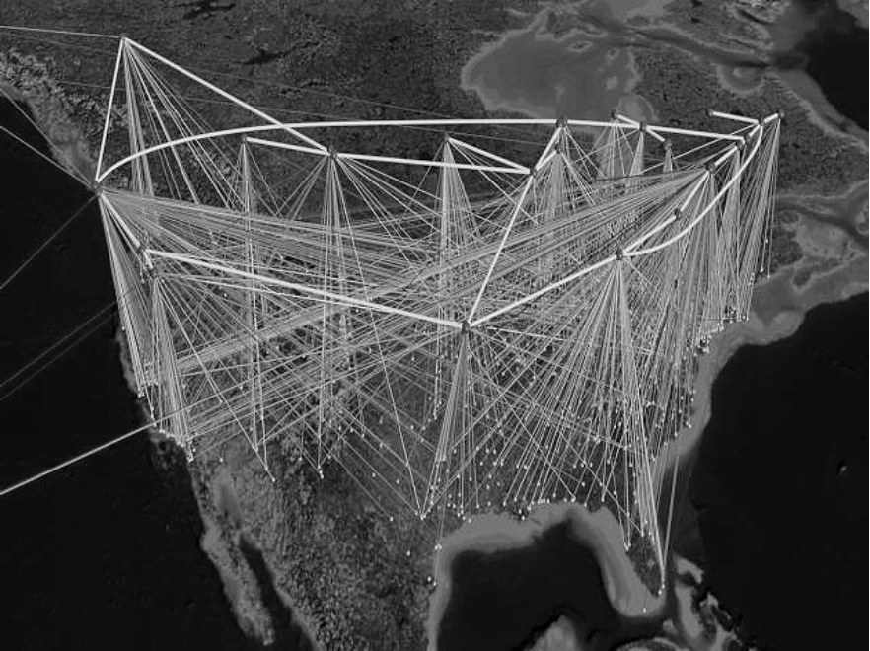
NSFNET
1974: TCP/IP
Robert Kahn & Vinton Cerf
Protocol: “language” for devices
Scalable way to connect hosts
Became part of “Internet” in 1983
1985 – 1995: NSFNET
Academic research network
Not for commercial activities until 1990s!
Three tiered structure
Backbone had 14 nodes by 1991

Slide 8
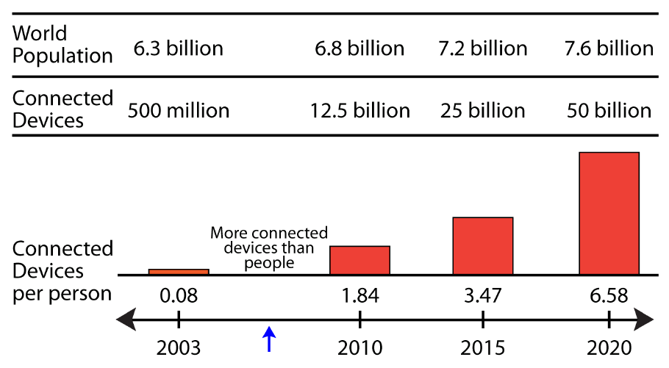
The “Internet”
Early 1990s
Internet Service Providers (ISPs)
1994: World Wide Web (WWW) & web browser
1995: NSFNET decommissioned, superseded by commercial “Internet”
Number of devices
Today: 2 – 3 times more interconnected devices than people
2020: 6 – 7 times …

Slide 9
Circuit Switching Advantage
Debate runs far and deep
Guarantee of Quality
Circuit Switching
Each session has a dedicated circuit
Throughput and delay performance will not change!
Packet Switching
Best-effort service: no guarantees
Links get congested, messages arrive out of order, …

Slide 10
Packet Switching Advantages
Ease of Connectivity
no need to allocate resources first
transmit at will, as long as protocols are followed
Scalability
large number of diverse sessions
obtained through high efficiency
(1) Statistical multiplexing
(2) Resource pooling

Slide 11
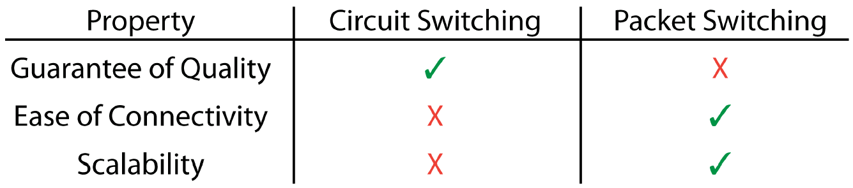
Packet vs. Circuit Summary
In the end, packet switching won the day
Not clear until early 2000s
Scalability first, then search for other quality control solutions

Slide 12
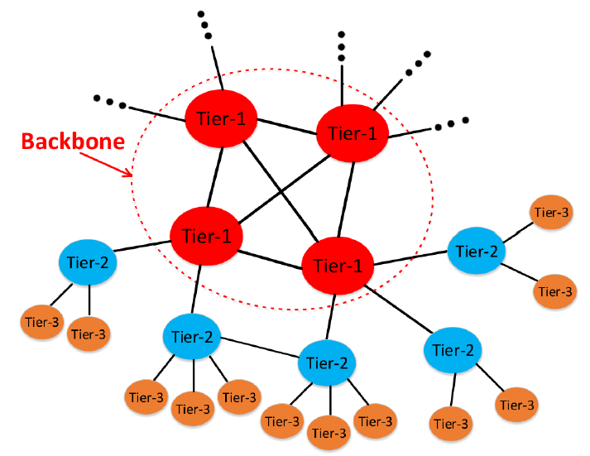
Distributed Hierarchy
Internet is large geographically
ISPs own different portions
tier-1: AT&T, Verizon, Level 3, …
global footprint
full mesh peering
form Internet backbone
tier-2: Vodafone, Comcast, …
may also peer
customer-provider with tier-1
tier-3: campus, corporate, …
take traffic only to and from customers
customer-provider with tier-2
Each ISP is an Autonomous System (AS)

